Slide 1
Orientation and Introduction to HTML
Front-End Web Development

Slide 2
Lesson 01 Change Log FEWD 3.1 - 3.2
No changes.
Share how the lesson went through our Instructor Lesson Exit Ticket - the Curriculum Feedback form: http://ga.co/curriculum-feedback

Slide 3
Pre-Class Materials and Preparation
Review all slides, lab activities, and code-alongs.
There are prompts in the speaker notes with opportunities for instructor customization.
If teaching remote, use breakout rooms for partner and group activities, and try adapting some of the partner exercises into small groups depending on your class size. For discussions, use slack threads to collect responses and review them after some time has passed. Be sure to frequently check in with students and solicit responses via slack during instruction.
For more remote teaching guidance, the myGA "How to Teach Online" course is available.
Materials
Reference Code
Starter Code in CodePen
Solution Code in CodePen

Slide 4
Introduction to HTML
Overview
This lesson introduces HTML elements and relationships, setting the stage for semantic HTML and CSS.
Learning Objectives
In this lesson, students will:
Create HTML documents using common element tags.
Inspect web pages using the browser’s developer tools.
Describe the relationship between HTML, CSS, and JavaScript in websites.
Duration: 180 minutes

Slide 5
Suggested Agenda
Time | Activity | Purpose
0:00–0:15 | Welcome | Introduce the lesson’s objectives and agenda. Ensure students are properly set up for the course.
0:15–0:30 | HTML Instruction | Understand HTMLs place in web development.
0:30–0:45 | Hello Inspector | Introduce the Chrome Inspector tool and ability to edit pages.
0:45–1:15 | Structure of HTML | Understand relationships between elements and the common tags.
1:15–1:30 | Recreate a Slide in HTML | Simple exercise translating content into HTML.
1:30 –2:00 | Press Release | Walk-through of using tags to define and shape content on a page.
2:00–2:30 | Kasserole | Partner exercise to recreate a simple HTML site.
2:30–3:00 | Cookie Time | Solo activity to recreate a site.
Notes:
TEACHING TIPS:
Check out the Training for Trainers (T4T) lesson “Planning Your Agenda” for tips. Ask your manager to provide access.

Slide 6
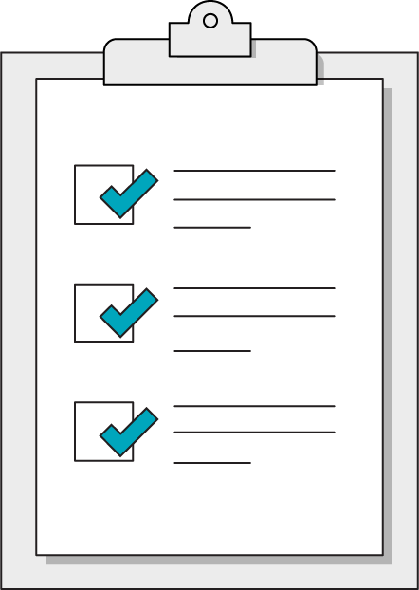
Today’s Learning Objectives
In this lesson, you will:
Set up our computing environment
Create HTML documents using common element tags.
Inspect web pages using the browser’s developer tools.
Describe the relationship between HTML, CSS, and JavaScript in websites.
Notes:
DURATION: 1 minute
TALKING POINTS:
Learning objectives help frame the lesson and give students an idea of what to expect and focus on.
TEACHING TIPS:
Explain to students how this lesson fits into the overall course to help them make connections with content from other lessons.

Slide 7

Tools We’ll Use
Slack for communication
A text editor
Google Chrome
CodePen
Trello for task management
Notes:
TEACHING TIPS:
Feel free to suggest a specific text editor and enforce a standard one across all students — it will be easier to show shortcuts, hotkeys, etc. You may want to pause on this slide and discuss each editor’s virtues or come back to it and have students install all of these things at once.

Slide 8

Resources
Stack Overflow for coding questions
CSS-Tricks for CSS/HTML questions
MDN for referencing standards of JS
CodePen for easy code sandboxes
CanIUse.com for browser compatibility checks
Notes:
TEACHING TIPS:
You can add your own favorite resources or suggest alternatives to the ones listed above. Early on and throughout the course, demonstrate how to google coding questions effectively, such as including the technology/langage you’re working with and identifying promising Stack Overflow results through upvotes and reading the question for context.

Slide 9
What Is Front-End Development?
Content
HTML
Style
CSS
Bones
Skin
Interactivity
JavaScript
Brain
Notes:
TALKING POINTS:
HTML is directions to the web browser about what should be displayed on the webpage — i.e., its content.
CSS is the style that’s added to that content.
JavaScript creates interactive elements.
Today, we’ll be practicing with HTML and CSS.

Slide 10
So, What Is HTML?
Front-End Web Development

Slide 11

HTML: Structure for Webpages
Notes:
TALKING POINTS:
Note that the building above doesn’t yet have any walls, any paint, electricity/appliances, etc.
This is HTML without CSS or JS. We will get to CSS and JS, but without HTML, there’s nothing holding it together. This is why we’re starting with it.

Slide 12
HTML Basics
<!DOCTYPE html>
<html>
<head>
<title>GA</title>
</head>
<body>
<p>Hey GA!</p>
</body>
</html>
<html> tag ALWAYS encloses the entire document
The doctype for all HTML documents is the same:
<!DOCTYPE html>. It is ALWAYS the first item on a page.
<head> and <body> tags are where page content go. The <head> contains what machines see, <body> is what people see.
Notes:
TEACHING TIPS:
This is the boilerplate for HTML. If you’ve had students install a text editor, this is a good time to show them the hotkey for an HTML boilerplate file, or save it for later in the day. This shows them that text editors can be very powerful tools for productivity and will get some more interested in shortcuts. If you type this out in your code editor for them, you can also show them autocompleting tags so they don’t have to type out the brackets.

Slide 13
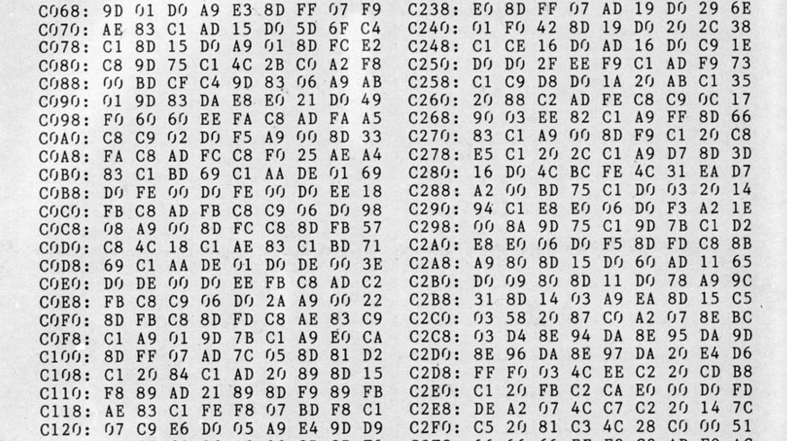
Most People Think HTML Is Programming — It’s Not!
Notes:
TEACHING TIPS:
Discuss the difference between a programming language and a markup language.
Students can guess what HTML means, if you haven’t explained it already.
The tags are essentially annotations for content and simply help define what type of content is on the page. A good comparison is that of a Google or Word doc. Adding and structuring content using either of those tools requires making decisions — what should be a heading 1, 2 or 3, bold vs. paragraph text, etc.

Slide 14
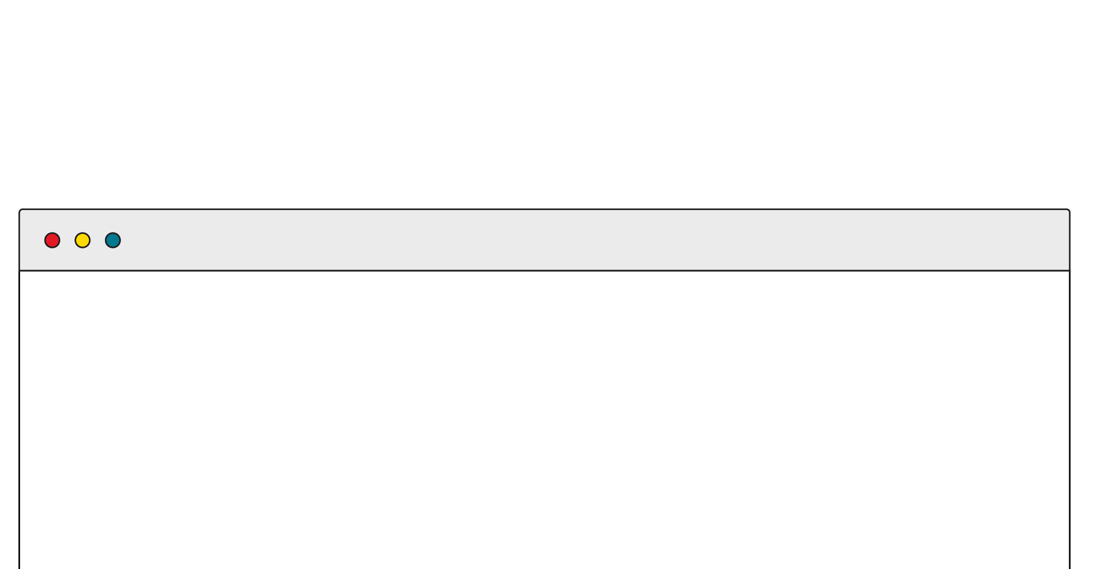
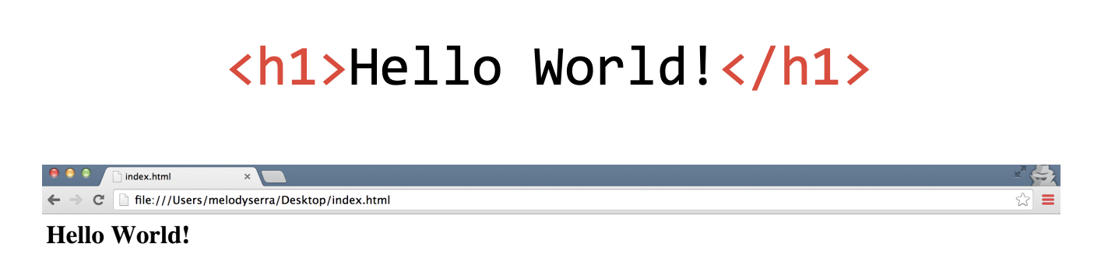
HTML: Hypertext Markup Language
HTML is made up of tags.
Tags tell the browser how to encode the content (e.g., will the content be formatted as an image or as a link?)
< >
These symbols surround every tag.
Notes:
TALKING POINTS:
HTML is made of tags — the double carets you see — which tell the browser how to format the content.

Slide 15
The Anatomy of HTML
Regular Tags
Self-closing Tags (aka Void Tags)
<p>Hello GA</p>
Opening
Tag
Content
Closing
Tag
<img src="picture.jpg" />
<img src="picture.jpg" alt="A picture">
Tag
Attribute
Notes:
TALKING POINTS:
Most elements require content to be placed between opening and closing tags, although some specific elements can be “self-closing” with no corresponding closing tag. This is for typical for elements that link out to external content — you’re not putting anything inside image tags because the image is the content.

Slide 16
Attributes
Attributes are additional information we add to an element.
They appear in the opening tag of the element.
They are made up of two parts: a name and a value, separated by “=”.
<a href=“http://www.amazon.com”>Amazon</a>
Name
Value
Href Attribute
Notes:
TALKING POINTS:
Attributes are additional information we add to an element. They appear in the opening tag of the element and are made of up two parts: a name and a value, separated by an “=” sign.
The attribute name indicates what kind of extra information you’re supplying about the element’s content.
The value is the information regarding the attribute.
The majority of attributes are unique to certain elements. One of these is the anchor element. Here, the href attribute gives us more information about the anchor — it tells the browser where to go when the user clicks on the text.
Additional resource: https://html-css-js.com/html/tutorial/html-tag-attributes.php

Slide 17
HTML Exercises
Front-End Web Development

Slide 18
Hello, Inspector!
10 minutes
Visit one of your favorite websites and identify three HTML tags used within it.
To view the HTML structure of a page using Google Chrome, simply right click on any element on the page and choose “Inspect.” This will open the DevTools panel (this is your new world!) and allow you to view and edit the HTML structure underlying the page.
Then, you might use resources such as W3Schools to get a sense of what the tag means and its most common use cases.
18 | © 2020 General Assembly
Notes:
TEACHING TIPS:
You can solicit answers from students and keep track of the tags they’ve identified. If you keep a tally of how often a tag is mentioned, this can create a picture of the most commonly seen/used tags, which should flow well into the next few slides that define the most common ones. You can also mention that divs/sections/etc. are containers for other tags and define the structure of the site (the DOM tree/parents/children). Hover over elements in the inspector to demonstrate its capabilities. Finally, you should demonstrate Inspector yourself and show how you can alter anything about a website by editing, adding, or deleting elements — note that this doesn’t actually save changes to the original page.

Slide 19
Structure of HTML
Front-End Web Development

Slide 20

Visualize Your HTML Tags as a Tree
Notes:
TALKING POINTS:
Tags help define a hierarchy for the website. The individual elements have relationships and connections to other elements nearby, including parent and children elements.
TEACHING TIPS:
You can go back to the site you inspected and point out some of these relationships.
What you want to show is the nesting of the tags, with the parent tags like <body>, <main> acting like the trunk of a tree and the <a>, <img>, <p> tags acting like leaves. Draw it on the board to emphasize what’s going on.

Slide 21
Elements Can Have Parents, Children, and Siblings
<body>
<h1>
<ul>
<li>
<li>
<li>
Notes:
Point out the siblings, children, and parent relationships in this diagram
Notice how the <body> is a parent one level up from the <h1> and the <ul>?
However, the <ul> is both a child of the <body> and a parent of the <li> elements — this is common with HTML.

Slide 22
Common Tags
Element | Description | Example
h1 | Main headings | <h1>The Explorer</h1>
h2–h6 | Subheadings | <h2>Articles</h2>
p | Paragraph of text | <p>This is a really cool site.</p>
a | Anchor tag for links to other web addresses | <a href=”google.com”> Search for stuff </a>
img | Images | <img src=”pic.jpg”>
Notes:
TALKING POINTS:
Without HTML, all text renders at the same level. We want to create hierarchy and structure to our site, so we start with indicating which text is a header, a subheader (of multiple levels), or just plain old paragraph text. Anchor and image tags can create connections between our webpage and other sites or image files.
TEACHING TIPS:
Walk students through the elements above.

Slide 23
Common HTML Tags: Lists
Element | Description | Example
li | List item | <ul> <li>Dragonfruit</li> <li>Oranges</li> <li>Apples</li> </ul>
ul | Unordered list
ol | Ordered list | <ol> <li>Monday</li> <li>Tuesday</li> <li>Wednesday</li> </ol>
Notes:
TALKING POINTS:
Next, let’s talk about adding another element to your page: lists. Lists are either unordered (with plain bullets) or ordered (with numbers). Ordered or unordered list tags will tell your browser to display the list item with a bullet or a number.

Slide 24
Tags in the Document Head
Element | Description | Example
link | Links a CSS style sheet. | <link href=”css/style.css”>
title | Website title that shows up in the browser tab. | <title>My website</title>
Notes:
TALKING POINTS:
Next, let’s talk about the elements found only in the <head> tag, such as <link> and <title>. The value assigned to <title> will be visible in the browsers tab for that page. <link> is used to import a CSS file. A page can import multiple CSS files and therefore would require a <link> tag to reference each one.

Slide 25
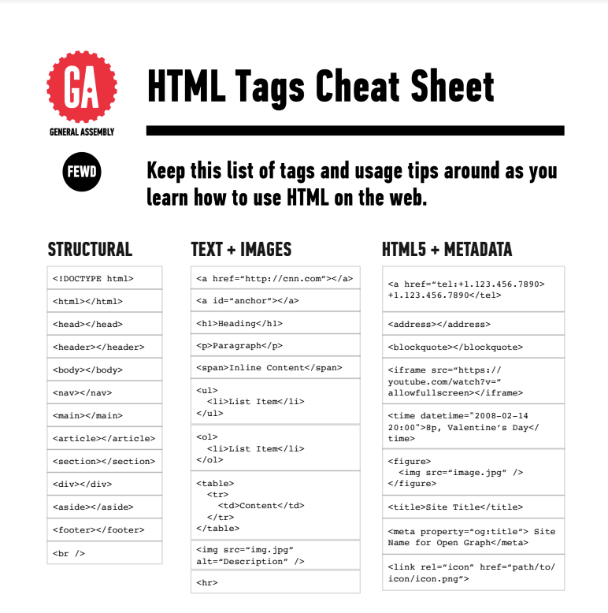
Cheat Sheet: HTML Elements
We’re providing a handy cheat sheet to reference HTML elements here.
The “Structural” and “Text/Image” lists in the cheat sheet are a good place to start when learning HTML. Forms will come later.
Notes:
TEACHING TIPS:
Because this will be student's first partner/group activity, suggest a specific tech setup for working together. Ideally, a pair programmer navigator/driver pattern should emerge, instead of two students working silently in parallel.
For remote classrooms, this will be their first breakout room experience, so give them some extra time to acclimate and pop in to as many rooms as possible to demonstrate that you can visit them as needed.

Slide 26
Let’s Recreate This Slide in HTML!
10 minutes
Hypertext Markup Challenge
Using the following HTML tags, recreate the contents of this slide, not including the teal title portion. Tags you should use include:
<h1>
<p>
<ul>
<li>
Notes:
TEACHING TIPS:
Because this will be student's first partner/group activity, suggest a specific tech setup for working together. Ideally, a pair programmer navigator/driver pattern should emerge, instead of two students working silently in parallel.
For remote classrooms, this will be their first breakout room experience, so give them some extra time to acclimate and pop in to as many rooms as possible to demonstrate that you can visit them as needed.

Slide 27
Press Release
Let’s make a press release together! We’ll take plain old text and apply HTML tags to define certain sections according to their role in the document.
Starter code:
https://codepen.io/GAmarketing/pen/YzzLyVp
Solution code:
https://codepen.io/GAmarketing/pen/YzzLyZG

Slide 28
Git
Front-End Web Development

Slide 29
What Is Git?
Git is a database for all of your code (version control).
It's a particular kind of version control called distributed version control. This means multiple people can make edits to the same codebase at once.
This can be a hard concept to wrap your head around — see the diagram on the next slide.

Slide 30
Server Computer
Version Database
version 3
version 2
version 1
Computer A
Computer B
file
file
Version Database
Version Database
version 3
version 3
version 2
version 2
version 1
version 1
Image Source: git-scm.com

Slide 31
Git Commands
Command | Explanation
init | Creates a repository in the current directory (folder).
add | Stages the specified files to prepare them for a commit.
commit | Saves the current state of the repository.
push | Sends local repository contents to a remote repository.
clone | Downloads a remote repository onto your local machine.
pull | Syncs one version of a repository with another.
Notes:
TEACHING TIPS:
There’s a lot about GitHub that will be confusing at first. Demonstrating each of these steps and writing them on the board in sequence as a “cheat sheet” should be very helpful.

Slide 32
Let’s Set Up Our User
git config --global user.name “Your Name”
git config --global user.email “you@yourmail.com”
Notes:
TEACHING TIPS:
There’s a lot about GitHub that will be confusing at first. Demonstrating each of these steps and writing them on the board in sequence as a “cheat sheet” should be very helpful.

Slide 33
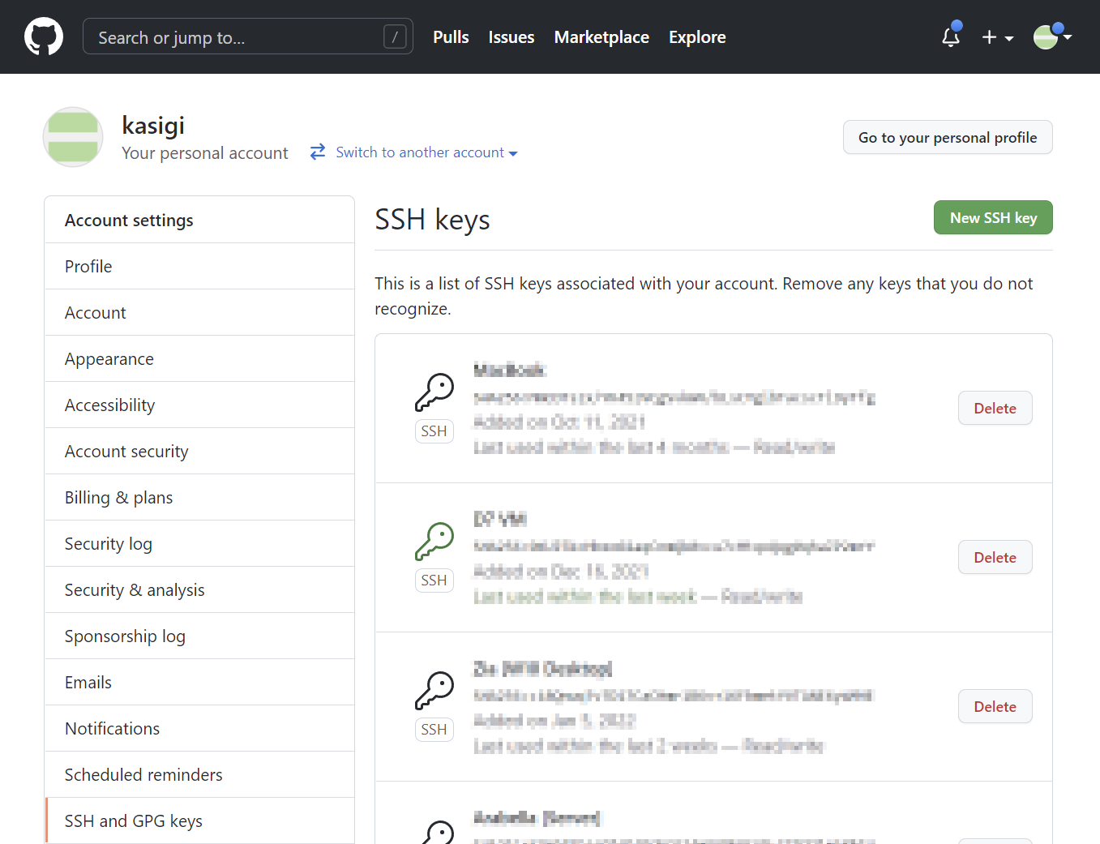
What Is Git?
SSH Keys are used to authenticate you with github
The private key stays on your computer
The public key is placed on github
Notes:
SSH Keys are stored in the user settings of github.

Slide 34
SSH Key Exchange
ssh-keygen
cat ~/.ssh/id_rsa.pub
Notes:
TEACHING TIPS:
There’s a lot about GitHub that will be confusing at first. Demonstrating each of these steps and writing them on the board in sequence as a “cheat sheet” should be very helpful.

Slide 35
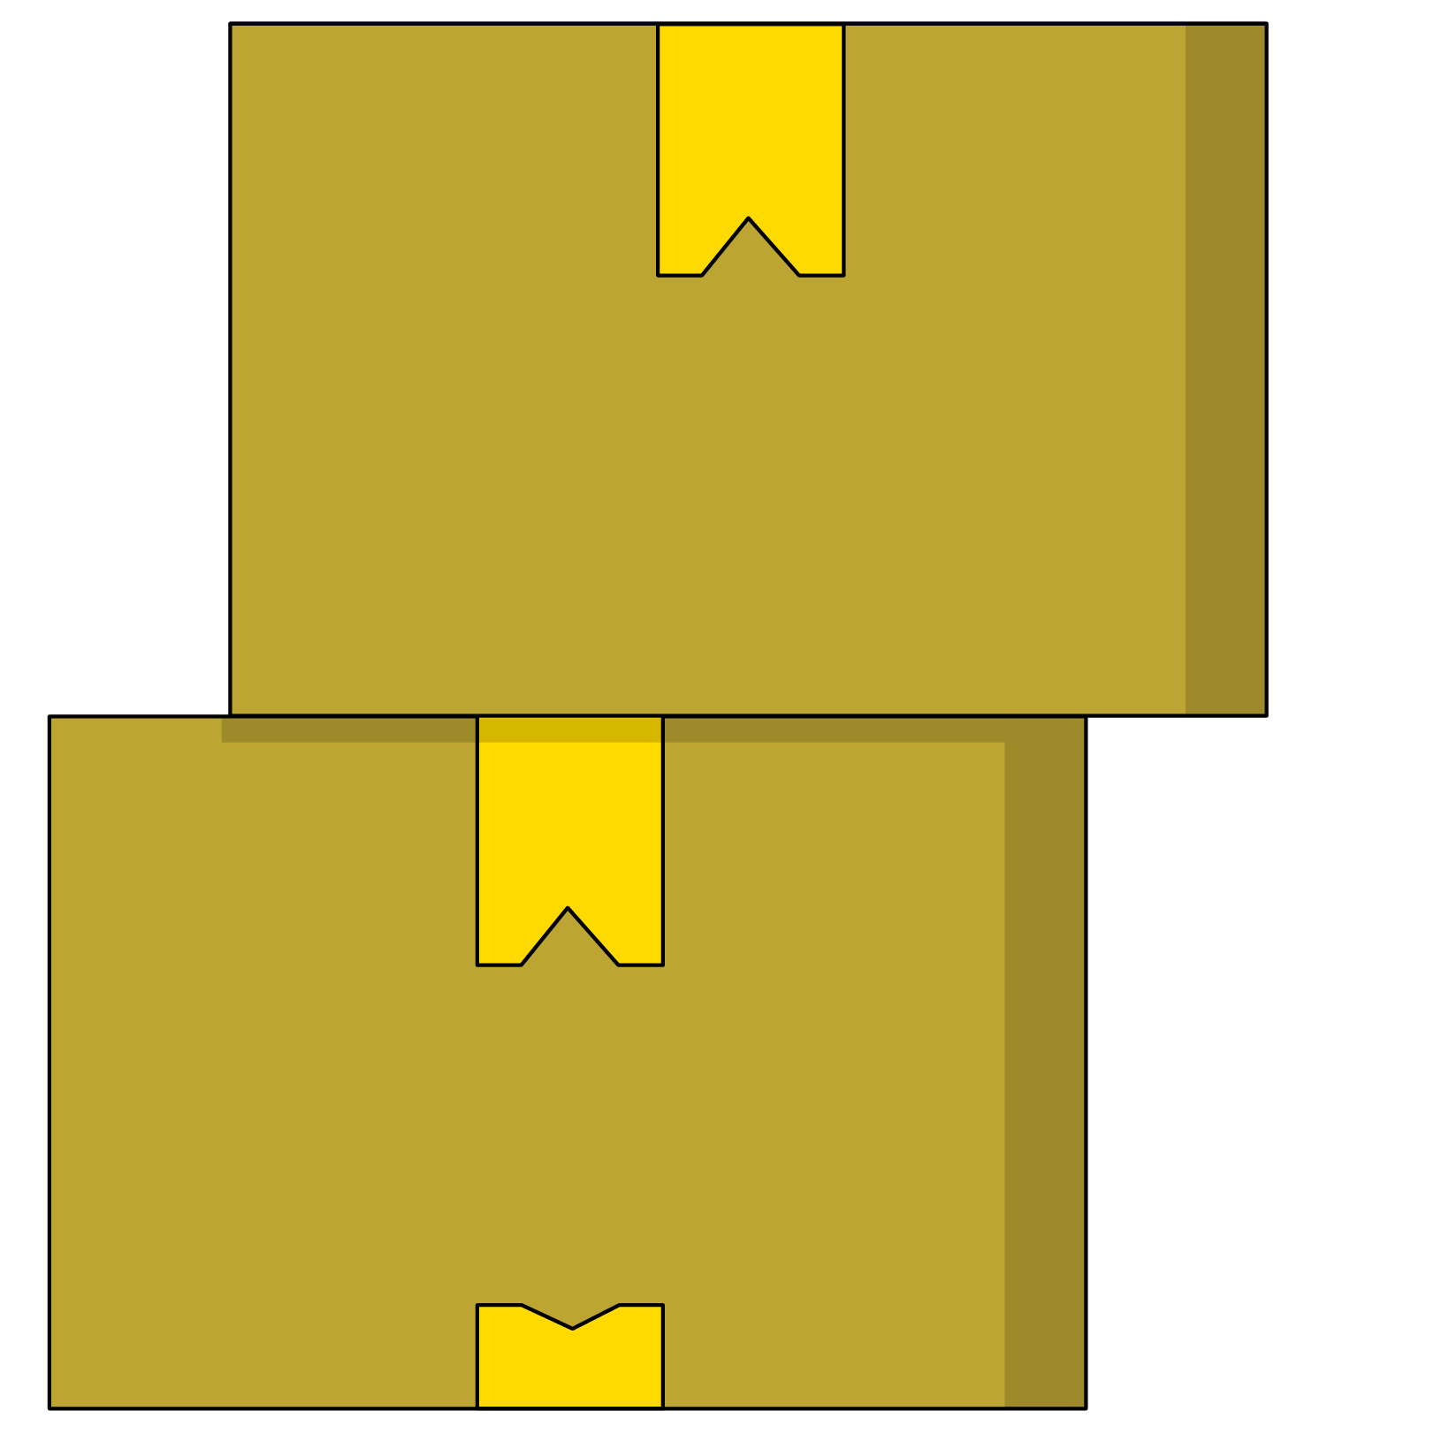
Creating Your Classwork Repo
Choose any of the previous assignments or projects and store them in a repository using the command line, then push that repository to a repository on github.com.
Use your text editor to create the folder structure and copy files into a new folder.
</ul>

Slide 36
Our First Hands-On Exercise
Front End Web Development

Slide 37
Bovine
Let’s tag an article together!
Our steps are:
Link the HTML, Images, and CSS
Add the content to the html
Tag the content

Slide 38
Kasserole
30 Minutes
Your goal is to experiment with formatting content in HTML. Fork the CodePen as your own. Then, code away! Add the hyperlinks properly, reference the image, create metadata, and get a real webpage going.
Starter code:
https://codepen.io/GAmarketing/pen/RwwyPLw
Solution code:
https://codepen.io/GAmarketing/pen/MWWGwoO

Slide 39
Cookie Time
30 Minutes
Follow the directions in the CodePen to add HTML tags to the given document. Think about the common tags we’ve seen. You can also sneak a peek at the CSS for a glimpse ahead at how style is applied to specific tags!
Starter code:
https://codepen.io/GAmarketing/pen/abbGvNe
Solution code:
https://codepen.io/GAmarketing/pen/jOOxbMK
39 | © 2020 General Assembly

Slide 40
Key Takeaways
For Next Time
HTML Is Content
Style!
Tags define and describe the content on a webpage.
Elements are related to each other via parent, child, and sibling relationships.
CSS will add style to our HTML elements.
CSS rules use selectors to select specific HTML tags to style.
40 | © 2020 General Assembly

